Slide 1
“Car business”
Rainbow team
G.Badamgarav Ts.Khongorzul

Slide 2
Topic
Introduction
Useful
Use case diagram
Usage
Summary

Slide 3
Introduction
This system need to customers and car fans. System’s users are:
Admin
Add /register/ car
Delete car
Update car
Search car
Customer
Buy car
Register sell to your car
Search car
We will implementation in use C#.

Slide 4
Useful
Car business company
set car`s information
Person who interested car
search by interested car
see car`s information
Person who interested sell your old car
if you have got a car to sell, you can register here.

Slide 5
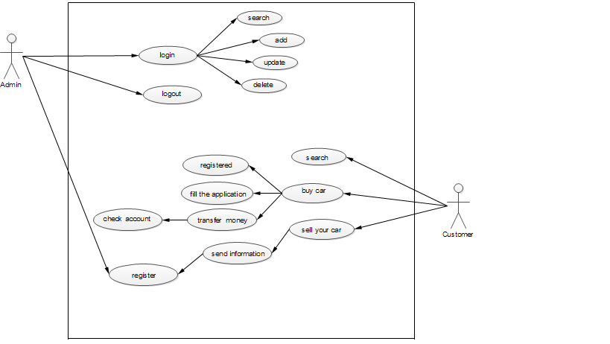
Use case diagram

Slide 6
Usage
Admin is login by username and password. If admin logged in these operations are available:
Search /Search by ID/
Add /New car’s register id, mark, color, type, capacity, the manufacturer company, date and sell price etc./
Update /Search by ID. All right update all information another from ID. /ID never changed//
Delete /Search by ID. If find a result, delete with all information them. /delete only served car//

Slide 7
Summary
By planning this project

